Slide 1






SENTIMENT ANALYSIS ON TWITTER MESSAGES
Rajasri Lekkala 11558355
Nitheesh Sama 11558355
Sai Krishna Bussa 11558355
Lokesh Bachu 11558355

Slide 2
Abstract :
Twitter has been a stage where people share their views and opinion on a particular product, thing, movie or an issue. The amount of data that is produced from this is so large and an organization that wants to know the public opinion on their products can make use of this data and analyze it to improve their products or services.
As part of our project, we are using a twitter dataset and perform sentiment analysis. Then we use sentiment in the tweets to analyze the performance of stocks in accordance with sentiment of the data.

Slide 3
Objectives :
In this project we will classify twitter messages into Positive, Negative, Neutral and Irrelevant based on the content of the messages
Will perform sentiment analysis on the dataset.
After performing the sentiment analysis, we would apply Machine Learning classifiers, evaluate the model and find the accuracy of the model
Analyze the stocks of the companies present in the dataset in accordance with sentiment.

Slide 4
Related Work :
The dataset is taken from Kaggle and consists of 3 columns company, kind and tweet.
This dataset has been used for sentiment analysis and a Decision Tree classifier model is already created to analyze the tweet sentiment of new tweets.
Pre-processing techniques also have been applied to increase the accuracy of the model.

Slide 5
Features:
Sentiment analysis is very important to understand and detect customer feelings. It is important to accomplish the project purpose using sentiment analysis because to understand real user opinions, complaints and suggestions.
The dataset we are using for sentiment analysis mainly contains three features they are the company’s product name , tweet related to the product and the status of the product.
Here the main feature is the tweet and the status of the product.
Another dataset is also used for stock market analysis. This is created based on the companies that are present in the 1st dataset.

Slide 6
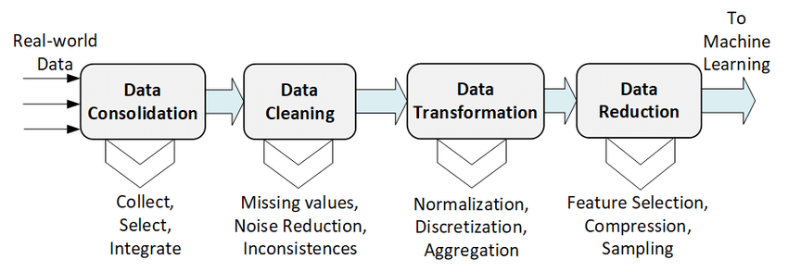
Data cleaning and preprocessing
Image Reference 14: Preprocessing steps composed of Data Consolidation, Data Cleaning,... | Download Scientific Diagram (researchgate.net)

Slide 7
Dataset:
In this project we are using 2 datasets. The 1st dataset is used for model building and 2nd is used for stock market analysis after knowing sentiment of the accuracy.
We extract important features from the 1st dataset that help in prediction of sentiment of new tweets.

Slide 8
Feature Design :
Twitter sentiment analysis has been Implemented to analyze the users perspectives towards the marketplace.
This is machine-based learning approach which is more accurate for analyzing a sentiment, with natural language processing techniques.
Creating data frame from the data object.
Performing tweet pre-processing by removing stop words , punctuation etc.
Here we will performing the Lemmatization on dataset

Slide 9
Software and Algorithms Dependencies
Python Version-min 3.9.0
Any Python Compiler
DecisionTreeClassifier
roc_auc_score
yfinance package

Slide 10
Implementation
Applying vectorization the final dataset Applying vApplying vectorization the final dataset ectorization the final dataset
creating data frame
performing tweet pre-processing by removing stop words
performing Lemmatization
Applying vectorization the final dataset
Splitting data
Sentiment analysis
Creating Decision tree classifier and performing model fitting
Accuracy test of the model
Positive
Negative

Slide 11
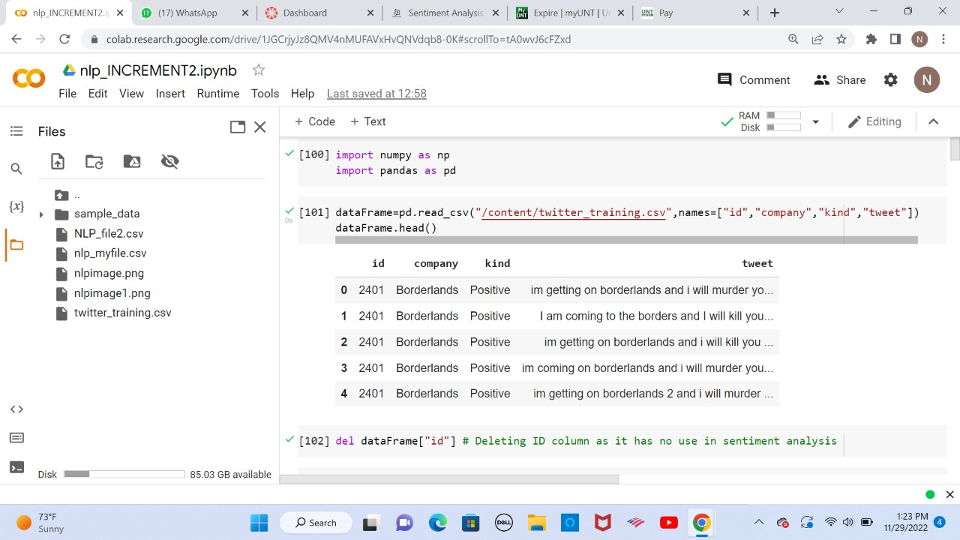
Results

Slide 12
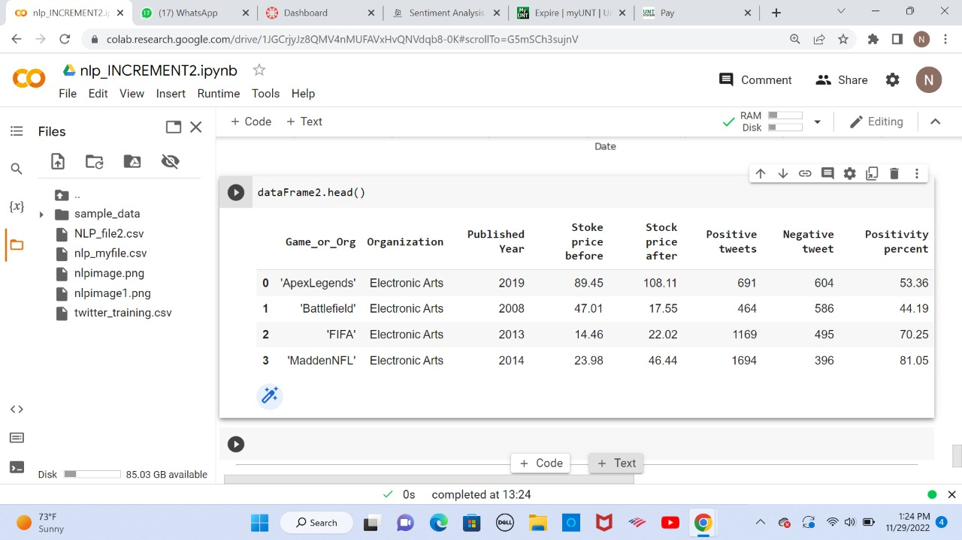

Slide 13
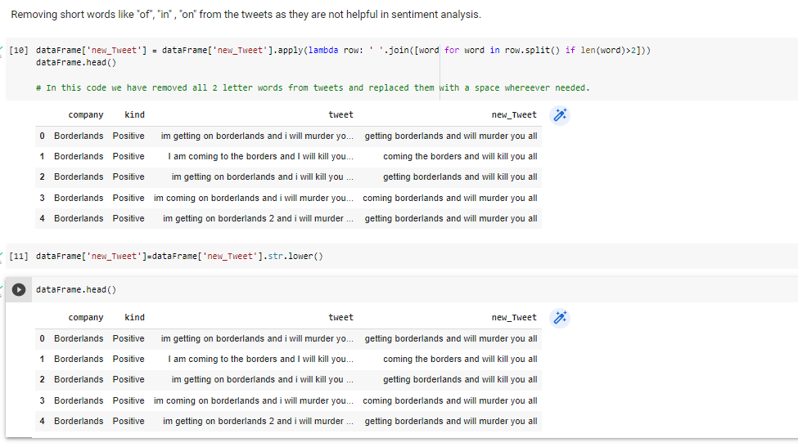

Slide 14
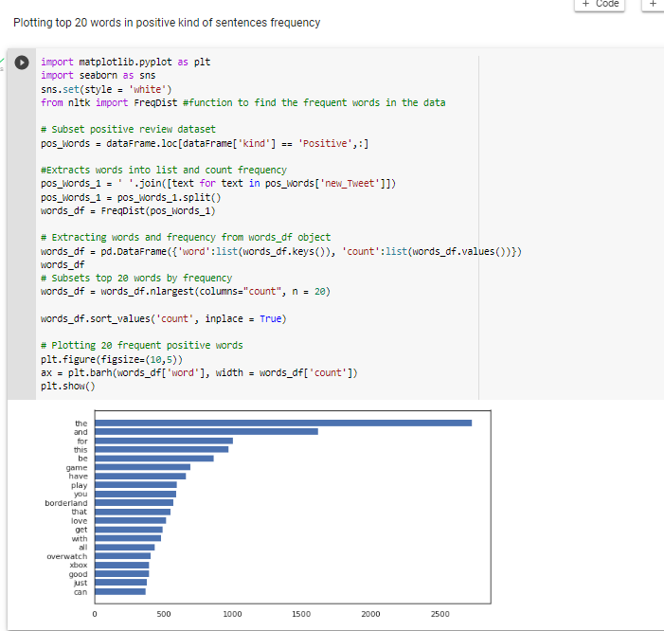
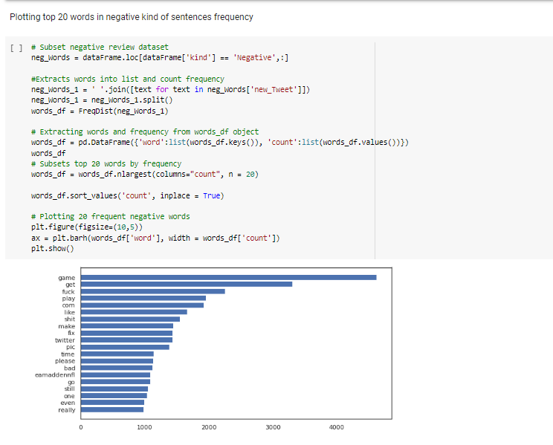

Slide 15
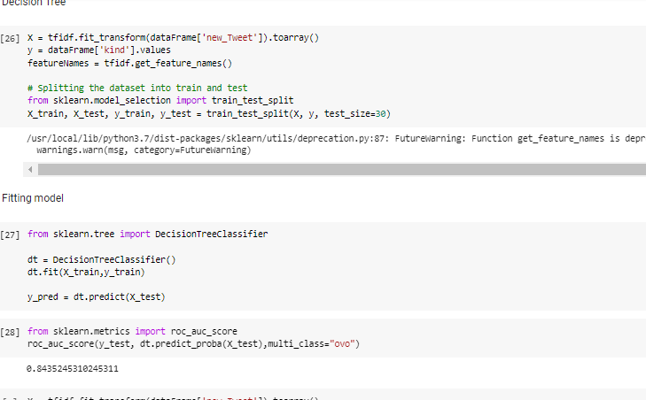

Slide 16
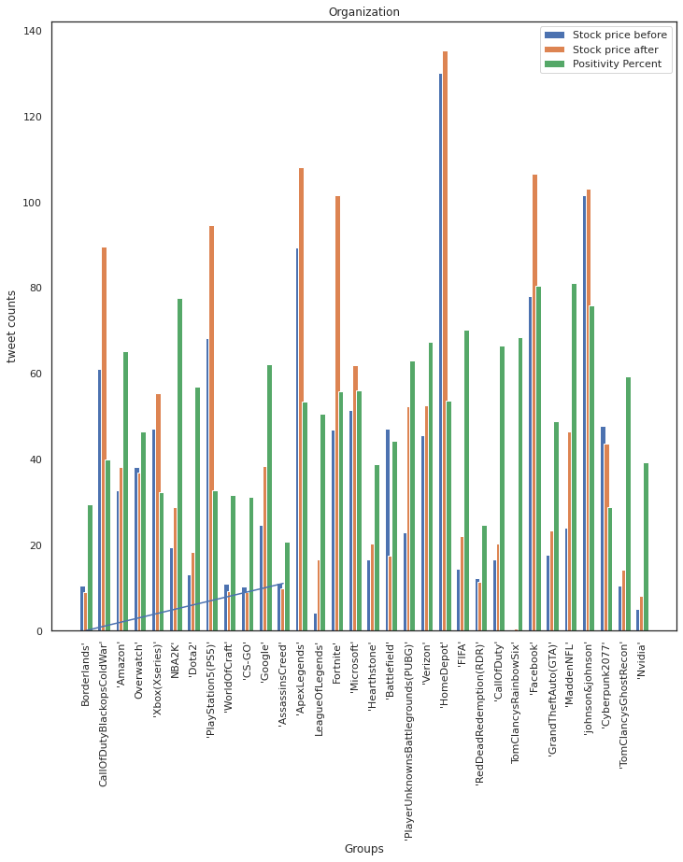

Slide 17

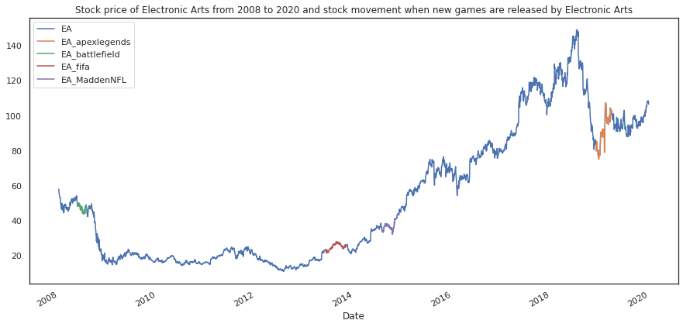



Slide 18
References:
https://www.kaggle.com/
https://finance.yahoo.com/

Slide 19
Thank you.

